Slide 1
CAR DAMAGE ASSESSMENT
APPLICATION OF COMPUTER VISION AND DEEP LEARNING TO ASSESS DAMAGED CARS

Slide 2

VGG 16 ARCHITECTURE
We fine-tune last
group of layers
We retrain fully-
connected classifier

Slide 3
DEVELOPING A PIPELINE

Slide 4
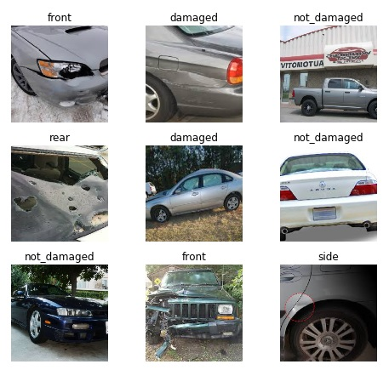
DEVELOPED CASE

Slide 5
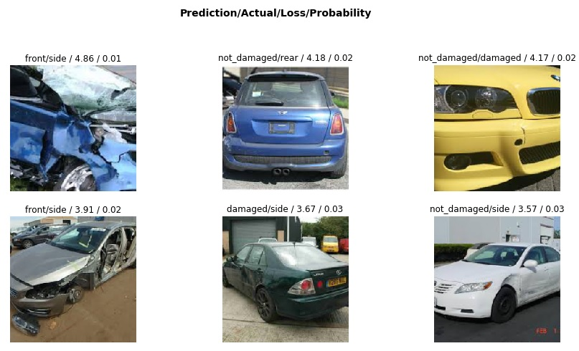

Slide 6
FUTURE WORK
○ Masked R-CNN, Fast R-CNN, Faster R-CNN etc,
○ With a higher quality dataset (including make and mode, location information, repair cost, etc.), we could go one step further and predict the cost of damaged based on image.

